Slide 1
Fundamental computing
Task 1
International Foundation Studies

Slide 2
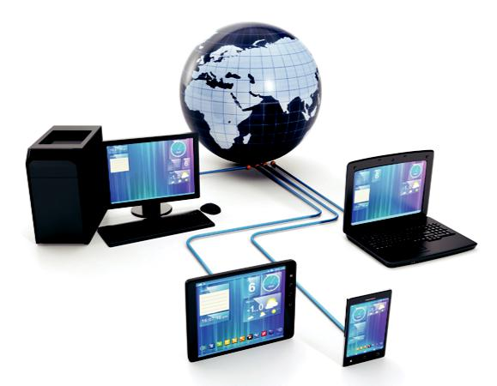
Types of computers system
Personal/desktop computers
Personal computers, or general purpose computers, are used by individuals for many reasons.
Personal computers have various standard components such as a tower, monitor, keyboard, mouse .
Some users create and store documents, some play games, others create music, video and photographic content; the applications are endless.

Slide 3
Laptop computers/netbooks
Laptop computers or notebooks are many people’s preferred choice of computer because they offer the same processing capabilities as a desktop computer but are portable.
Many families choose to buy a laptop instead of a desktop computer because they take up so little space, can be moved around the house depending on who is using it, and can be packed tidily away.

Slide 4
Tablet computers
Tablet computers are portable computers with slightly smaller screens than an average laptop.
Their defining characteristic is that user interaction is all through touch. There is no mouse or keyboard.
Users can swipe, pinch, drag and rotate icons on the screen to activate tasks, control the cursor and input data. The use of solid state flash memory (see Unit 3) means that these devices switch on and are ready for use very quickly.

Slide 5
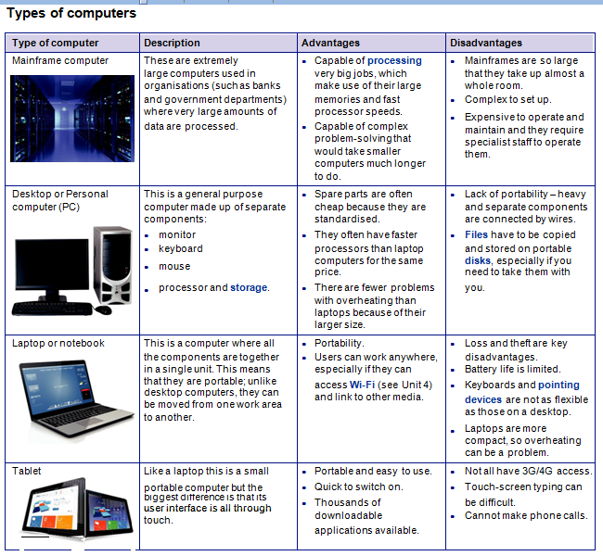

Slide 6
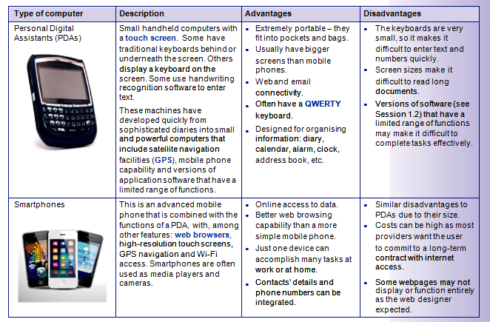

Slide 7
Hardware components
Hardware
When you look at a computer and all the peripheral devices that are attached to it, you can see examples of hardware such as:
● monitor ● mouse ● speakers
● keyboard ● printer ● scanner
Some peripheral devices have more than one function. Many people now choose to have their scanner, photocopier and printer together in one device, which are widely known as All-In-One printers. Touch-sensitive screens allow us to use them as input devices as well as output devices (see Session 2.1, page 62).
Having an external hard drive is an excellent way of giving yourself extra portable storage space as well as providing a backup facility.

Slide 8
What are the characteristics of hardware?
Computer hardware is the collection of physical parts of a computer system. This includes the computer case, monitor, keyboard, and mouse. It also includes all the parts inside the computer case, such as the hard disk drive, motherboard, video card, and many others. Computer hardware is what you can physically touch.

Slide 9
the four basic functions of a computer system are as follows:
input.
output.
processing.
storage.

Slide 10
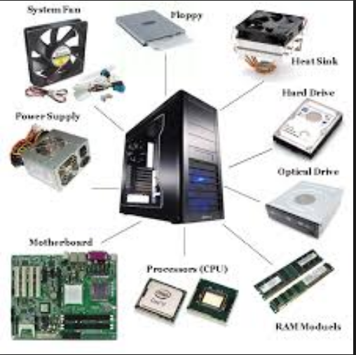

Slide 11
Activities
Write the names of input and out put devices.
Names of storage devices.
Data Processing mechanism.
Identify the components of the computer hardware

Slide 12
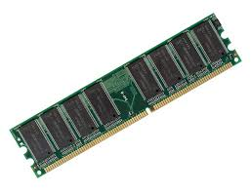

Slide 13
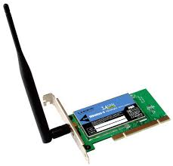
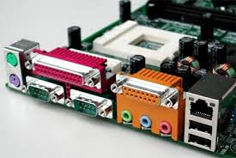

Slide 14
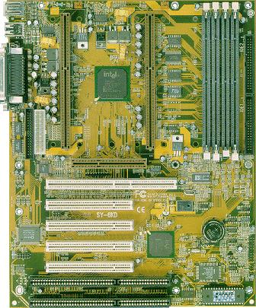

Slide 15
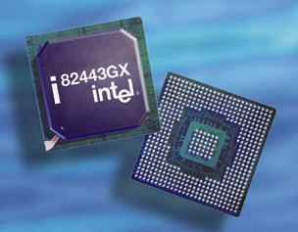

Slide 17
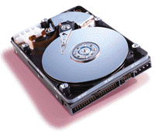

Slide 18
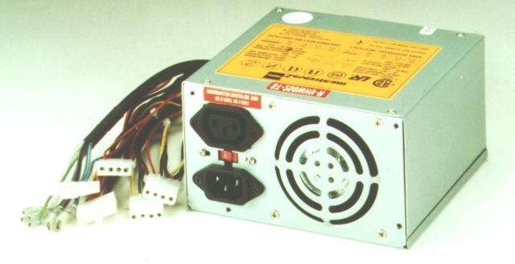

Slide 19
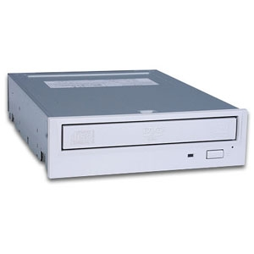

Slide 20
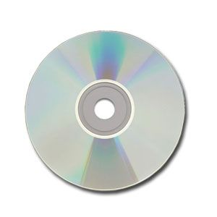

Slide 21



